Slide 1
DJANGO basic view
江琳

Slide 2
Philosophy
The following three classes provide much of the functionality needed to create Django views.
View
TemplateView
RedirectView

Slide 3
view

Slide 4
view
class django.views.generic.base.View
The master class-based base view.
All other class-based views inherit from this base class. It isn’t strictly a generic view and thus can also be imported from django.views.

Slide 5
Library system
Part one: Library System
Homepage
Book list page
Book detail page
Part two: Library Management System
Login page
Create book, author, publisher, category
Book list
Update book

Slide 6

Login page with view
from django.contrib.auth import authenticate, login from django.contrib import messages from django.core.urlresolvers import reverse from django.shortcuts import render, redirect from django.views.generic import View
class Index(View): def get(self, request): return render(request, 'backstage/index.html') def post(self, request): username = request.POST.get('username') password = request.POST.get('password') user = authenticate(username=username, password=password) if user and user.is_superuser: login(request, user) return redirect(reverse('bs_list')) messages.error(request, 'username or password is incorrect！') return redirect(reverse('index'))

Slide 7

Login page with view
Add url
url(r'^backstage/$', Index.as_view(), name='index'),

Slide 8

<body> <div class=“title”>Management Login System</div> <div class=“login”> <form method=“post”> {% csrf_token %} <p style=“height: 15px”> {% for msg in messages %} <span class=“{{ msg.tags }}”>{{ msg }}</span> {% endfor %} </p> <p> <label>Username:</label> <input type=“text” name="username"> </p> <p> <label>Password:</label> <input type="password" name="password"> </p> <input type="submit" value="Submit"> </form> </div> </body>

Slide 9

<style> body { background-color: #609ab6; text-align: center; } .title { margin-top: 60px; color: #fff; font-size: 54px; font-weight: bold; } .login { text-align: center; margin: 15% auto; background-color: #fff; border-radius: 5px; width: 300px; height: 150px; padding: 10px; } .error { color: #ff0000; } </style>

Slide 10
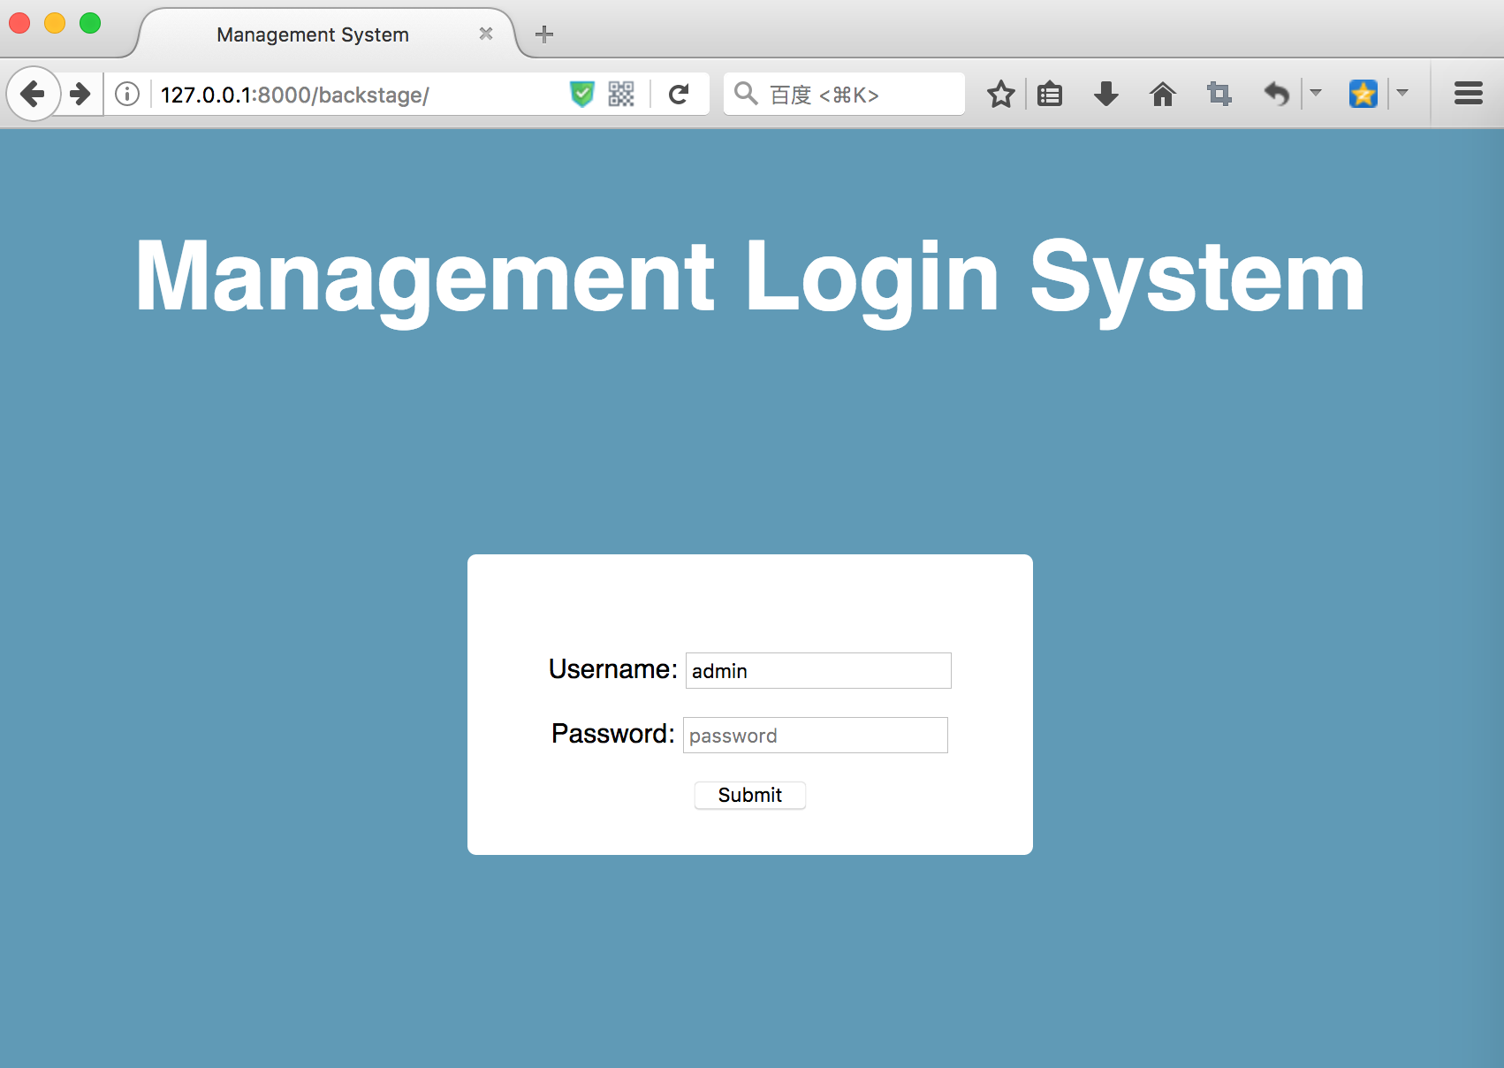
Login page with view

Slide 11
Login page with view
http method name
The list of HTTP method names that view will accept:
['get', 'post', 'put', 'patch', 'delete', 'head', 'options', 'trace']

Slide 12
Login page with view
user = authenticate(username=username, password=password)
Use authenticate() to verify a set of credentials. It takes credentials as keyword arguments, username and password for the default case, checks them against each authentication backend, and returns a User object if the credentials are valid for a backend. If the credentials aren’t valid for any backend or if a backend raises PermissionDenied, it returns None.

Slide 13
Login page with view
login(request, user)
login() is used to log a user in. It takes an HttpRequest object and a User object. login() saves the user’s ID in the session, using Django’s session framework.

Slide 14
Login page with view
return redirect(reverse('bs_list'))
redirect() returns an HttpResponseRedirect to the appropriate URL for the arguments passed.

Slide 15
Login page with view
Messages tags
Message tags are a string representation of the message level plus any extra tags that were added directly in the view
Level Constant | Tag
DEBUG | debug
INFO | info
SUCCESS | success
WARNING | warning
ERROR | error

Slide 16
{{ csrf_token }}
The CSRF middleware provides easy-to-use protection against Cross Site Request Forgeries.
This type of attack occurs when a malicious website contains a link, a form button or some JavaScript that is intended to perform some action on your website.

Slide 17
templateview

Slide 18
templateview
Renders a given template, with the context containing parameters captured in the URL.
Method flowchart
dispatch()
http_method_not_allowed()
get_context_data()

Slide 19
Library system
Part one: Library System
Homepage
Book list page
Book detail page
Part two: Library Management System
Login page
Create book, author, publisher, category
Book list
Update book

Slide 20

templateview
Let’s modify Homepage using TemplateView
class Home(TemplateView): template_name = 'homepage.html' def get_context_data(self, **kwargs): context = super(Home, self).get_context_data(**kwargs) context['lastest_books'] = Book.objects.all().\ order_by('-id')[:5] return context

Slide 21

Homepage.html
<body style="text-align: center"> <h1>Library System</h1> <form method="get" action="{% url 'book_list' %}"> <input type="text" style="width: 60%;height: 30px" placeholder="searching" name="name"> <input type="submit" value="Search"> </form> <div class="new-books"> <h2>New Books</h2> {% for book in lastest_books %} <p><a href="{% url 'book_detail' pk=book.id %}"> <span style="font-size: 20px;font-weight: bold">{{ book.name }}</span> <span>--{{ book.author.name }}</span></a></p> {% endfor %} </div>

Slide 22
Homepage.html
<style> .new-books{ background-color: #cccccc; padding: 20px 0; margin-top: 20px; } </style>

Slide 23
url.py
from books.views import Home
urlpatterns = [ url(r'^admin/', include(admin.site.urls)), url(r'^$', Home.as_view(), name='home'), ]

Slide 24
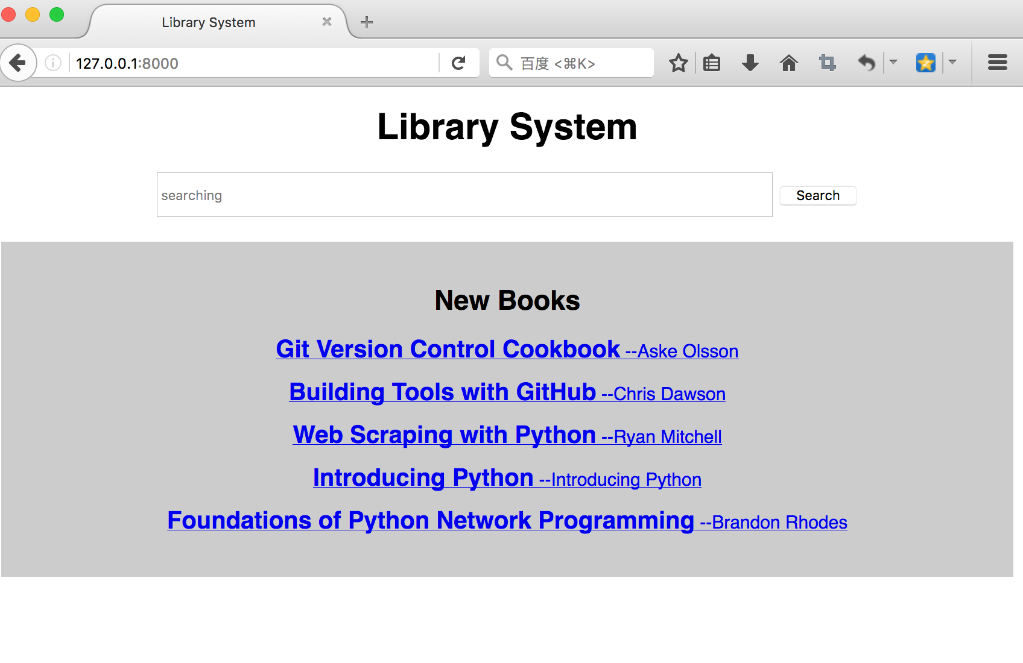
templateview

Slide 25

templateview
Something we don’t pass context to template, we can write the TemplateView to url.py directly
from django.views.generic import TemplateView
urlpatterns = [ url(r'^$', TemplateView.as_view(template_name='homepage.html'), name='home'), ]

Slide 26
redirectview

Slide 27
redirectview
Redirects to a given URL.If the given URL is None, Django will return an HttpResponseGone (410).
Method Flowchart:
dispatch()
http_method_not_allowed()
get_redirect_url()

Slide 28

redirectview
Accume we change the url from
url(r'^book/(?P<pk>\d+)/', BookDetail.as_view(), name='book_detail'),
to
url(r'^detail/(?P<pk>\d+)/', BookDetail.as_view(), name='book_detail'),
The old url will never usable, but some people don’t know the change and may use it again.
Now we need redirect the old url to the new one.

Slide 29
View.py
from django.views.generic import RedirectView
class BookDetailRedirect(RedirectView): permanent = False query_string = True pattern_name = 'book_detail' def get_redirect_url(self, *args, **kwargs): return super(BookDetailRedirect, self).get_redirect_url(*args, **kwargs)

Slide 30
url.py
urlpatterns = [ url(r'^detail/(?P<pk>\d+)/', BookDetail.as_view(), name='book_detail'), url(r'^book/(?P<pk>\d+)/', BookDetailRedirect.as_view()),

Slide 31
redirectview
Now if you open the page http://127.0.0.1:8000/book/1, it will automatic redirect to http://127.0.0.1:8000/detail/1.

Slide 32
Redirectview -- attributes
url
The URL to redirect to, as a string. Or None to raise a 410 (Gone) HTTP error.
pattern_name
The name of the URL pattern to redirect to.

Slide 33
Redirectview -- attributes
permanent
Whether the redirect should be permanent. The only difference here is the HTTP status code returned. If True, then the redirect will use status code 301. If False, then the redirect will use status code 302. By default, permanent is False.
query_string
Whether to pass along the GET query string to the new location. If True, then the query string is appended to the URL. If False, then the query string is discarded. By default, query_string is False.

Slide 34
redirectview
We can write the RediectView into url.py as well.
from django.views.generic import RedirectView
urlpatterns = [ url(r'^detail/(?P<pk>\d+)/', BookDetail.as_view(), name='book_detail'), url(r'^book/(?P<pk>\d+)/', RedirectView.as_view(pattern_name='book_detail')), ]

Slide 35
Questions?

